Slide 1
Modeling a Soft Modular Adaptive Robotic Technology (SMART) Arm
MAE263F Final Presentation
Che Jin Goh and Agathiya Tharun

Slide 2
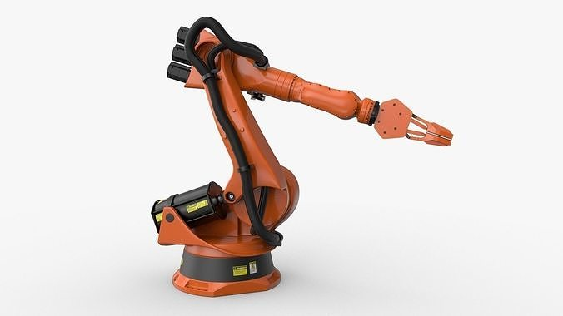
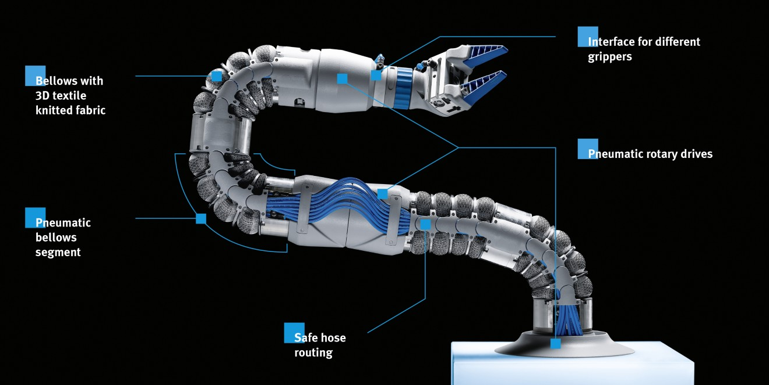
Background
Rigid Robotic Arms
Fixed joints locations and stiffness
Rigid structures
Limited adaptability
Limited workspace
Safety hazard during human-robot collaboration
Soft Robotic Arms
Flexible materials
Dynamic structures enhance versatility
Limited workspace
Increased safety in unpredictable environments
Increased adaptability and functionality
KUKA robotic arm
Bionic SoftArm
Notes:
Soft robotic arms are designed to overcome the limitations of conventional rigid robotic systems. Traditional robots are restricted by their fixed joints and rigid structures, which limit their ability to adapt to unpredictable environments. This restricts their reachable workspace, adaptability, and potential for safe collaboration with humans.
Soft robotic arms on the other hand, use flexible materials to enhance movement capabilities and versatility. However, there are still some challenges such as limited degrees of freedom and scalability issues due to bulky actuators, which hinder their potential for performing complex tasks. Our proposed research aims to address these challenges by developing a framework to expand the capabilities of soft robotic arms. By developing a customizable framework for a modular arm, aka the SMART Arm, researchers can test various design configurations to find optimal solutions for their use cases and study their performance.

Slide 3
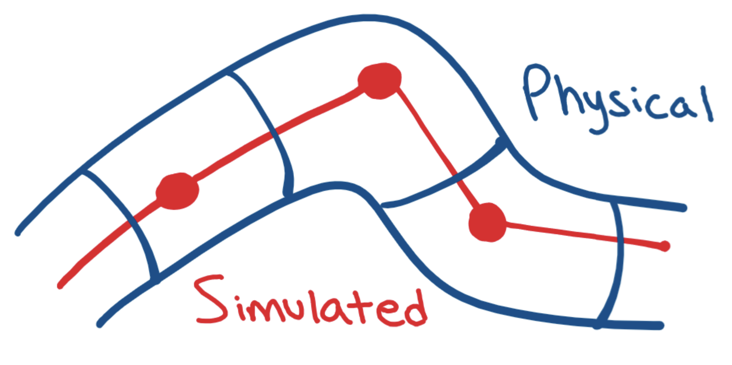
Overview
Goal:
Simulate a modular soft robotic arm
Develop a foundational framework for researchers to leverage and tweak to model their proposal
Method:
Assign variable stiffness to each node
Apply forces to “spawned joints” in a representative way to induce bending
Unstiffened nodes
Notes:
The SMART Arm is meant to be a highly customizable and modular framework capable of tackling a wide variety of problems.
Forces are applied in a way representative of feasible actuation methods currently employed in physical soft robotic arms (applying nodally instead of at end-effector). Simulates muscle contraction and granular packing methods.

Slide 4
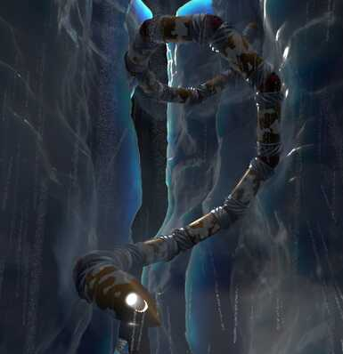
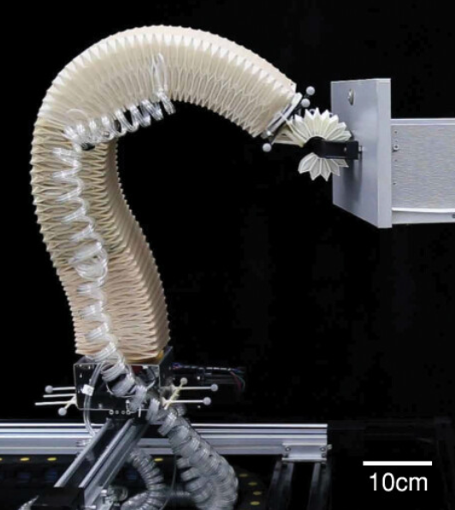
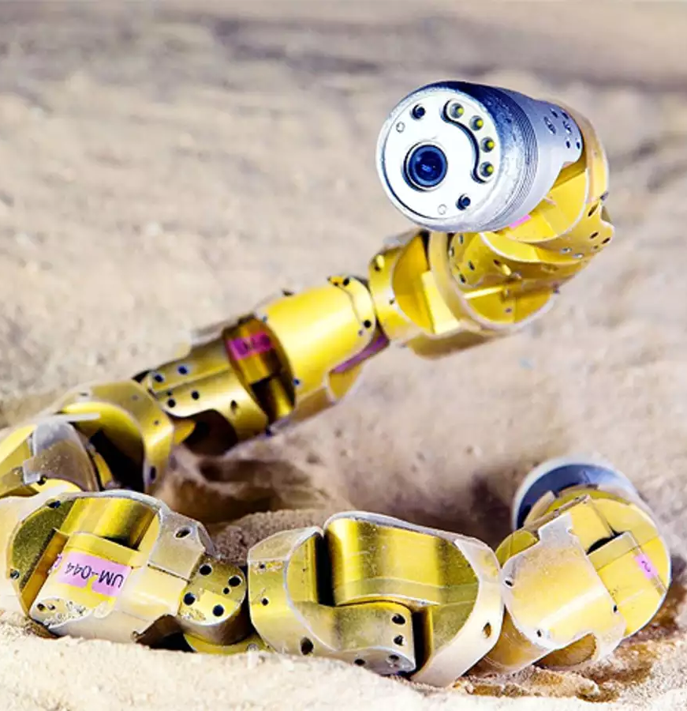
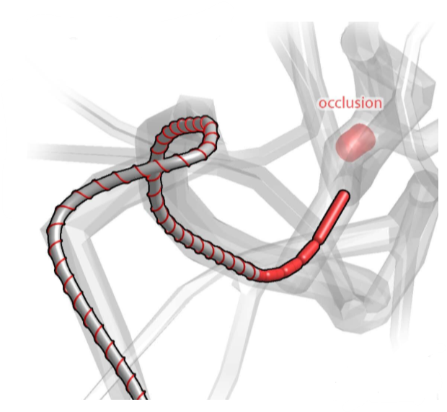
SMART Arm Applications
Increased workspace and dexterity
Various traversal capabilities
Increased safety
Cave traversal/climbing
Arm functionality
Burrowing and rescuing
Intravascular travel
Notes:
The goal of the SMART Arm framework is to lead researchers towards an optimal design configuration for a soft-robotic arm. Such an arm can be highly proficient in one application or designed to be multifunctional, ranging across various capabilities such as_____. A successful SMART Arm has the potential to be highly influential and capable.

Slide 5
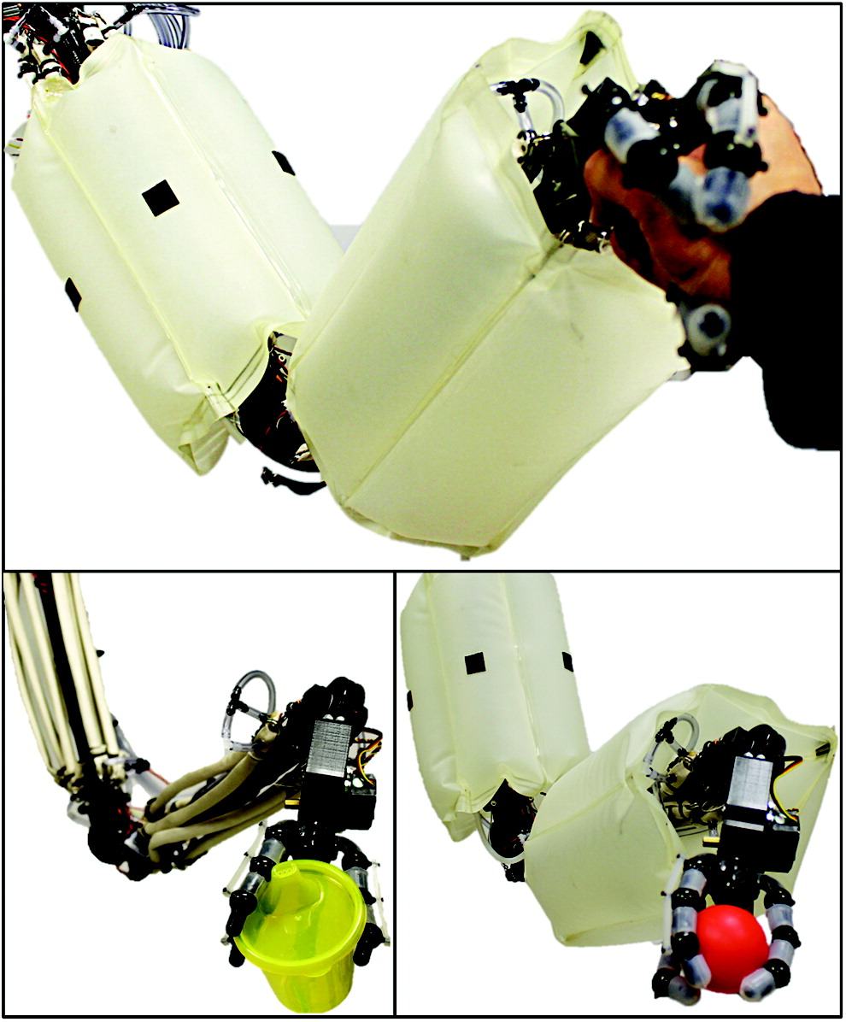
Hypothetical Physical Representation
Thermally induced density, pneumatic, hydraulic, dielectric elastomer, shape memory alloy/polymer, and fibrous actuation
Dynamic link length
Joint location
Variable joint stiffness
Second Moment of Area
Node count
Notes:
Using these actuation methods, the following modular characteristics can be achieved.

Slide 6
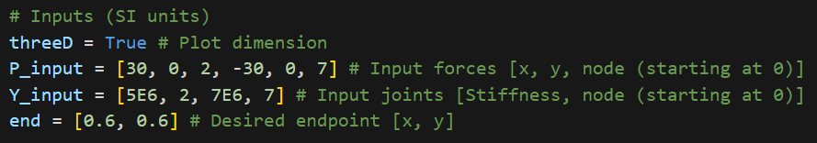
Simulation Capabilities
Inputs:
Dimension (2D or 3D representation)
Force vector and location
Nodal stiffness
Desired endpoint
Notes:
The SMART Arm simulation framework can successfully model the versatile smart arm showcasing its many features. Convergence tolerance depends

Slide 7
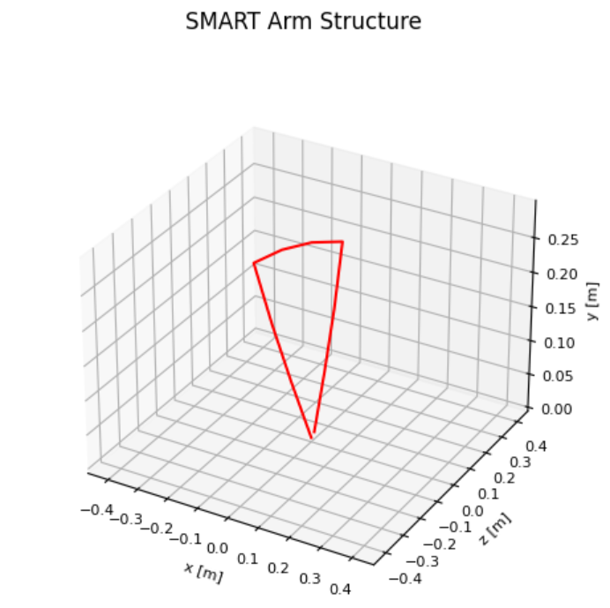
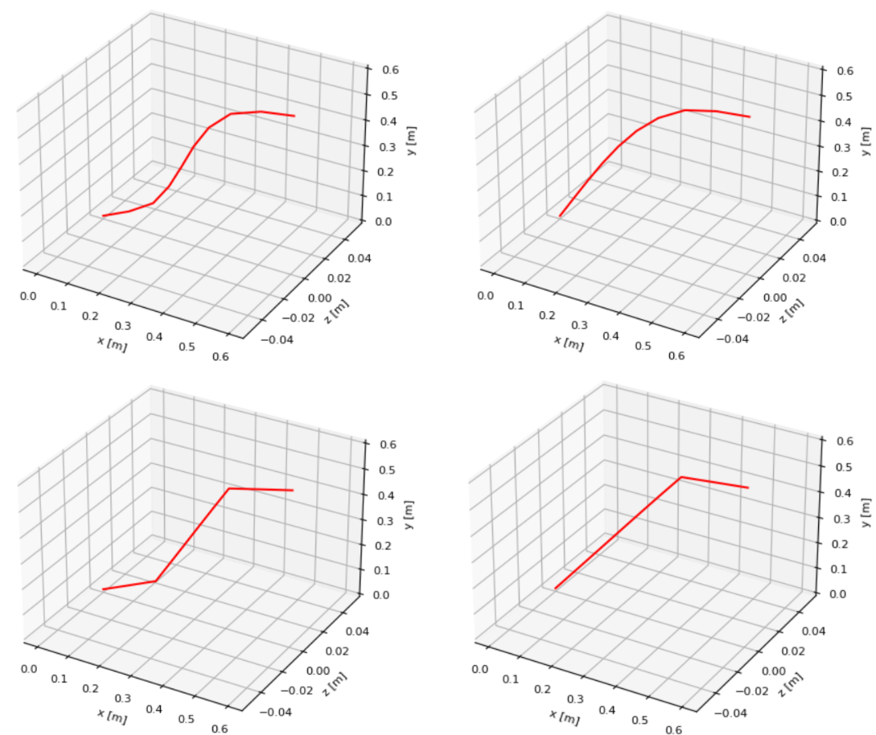
Simulation Capabilities
User-defined number of nodes, lengths, and nodal stiffnesses
Applied 1-DOF forces to induce bending at “spawned joints”
Mimics physical contraction and rotational actuation
SMART Arm can reach tight spaces near the base that traditional arms cannot; enhanced workspace
Fluid and continuous structure
Variable DOF based on task
Base
Endpoint
Notes:
The SMART Arm simulation framework can successfully model the versatile smart arm showcasing its many features. Convergence tolerance depends

Slide 8
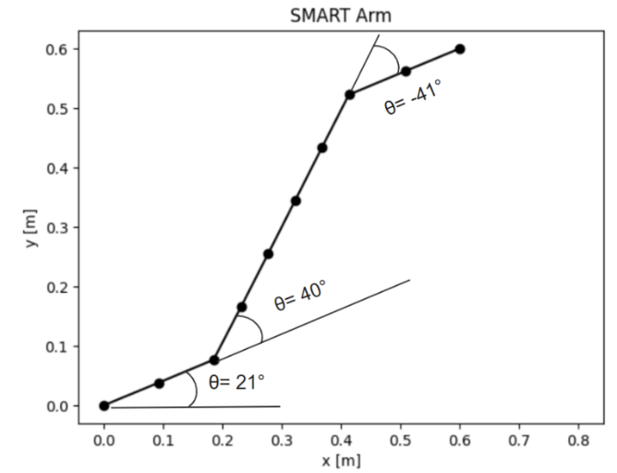
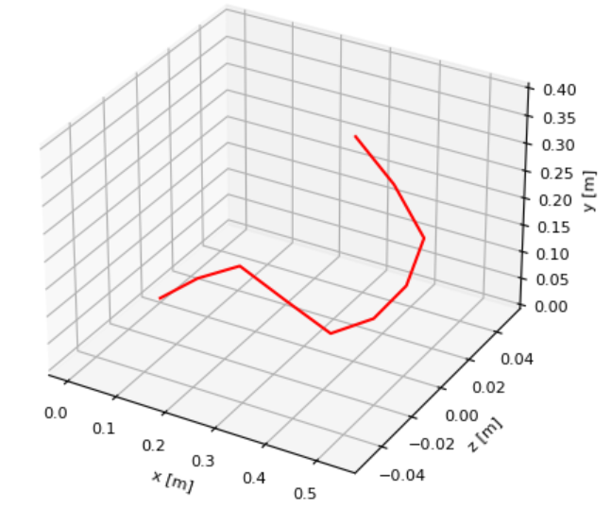
Inverse Kinematic Solver
Inputs:
Variable joint stiffness
Manual force inputs
Target endpoint location
Functionality:
Detects “spawned joint” positions dynamically
Computes required joint angles based on constraints
Outputs:
Spawned joint angles
Obs
Obs
Notes:
After we pass in the variable joint stiffness input and the end effector location, we can then determine the forces to apply according to how we want the arm to bend. Given that forces are an input, we can tweak it to have it avoid obstacles or reach the position in a more efficient manner. Our framework can then work like an inverse kinematics solver and produce the necessary angles to achieve an end point, and it does this by looping through all the stiffness on each node and determining which nodes are joints, then calculating the angle like so.
Using these joint angles, researchers can then find the relationship between joint angles and actuator forces required for their specific model.

Slide 9
References
Fitzgerald, Seth G., Gary W. Delaney, and David Howard. 2020. "A Review of Jamming Actuation in Soft Robotics" Actuators 9, no. 4: 104. https://doi.org/10.3390/act9040104
Hajiesmaili, E., & Clarke, D. R. (2021). Dielectric elastomer actuators. Retrieved from https://pubs.aip.org/aip/jap/article/129/15/151102/1025587/Dielectric-elastomer-actuators
Katzschmann, R. K., Santina, C. D., Toshimitsu, Y., Bicchi, A., & Rus, D. (2019). Dynamic Motion Control of Multi-Segment Soft Robots Using Piecewise Constant Curvature Matched with an Augmented Rigid Body Model. In 2019 2nd IEEE International Conference on Soft Robotics (RoboSoft) (pp. 454-461). IEEE. https://doi.org/10.1109/ROBOSOFT.2019.8722799
Mazzolai, B., et al. (2012). Bioinspir. Biomim. 7, 025005. https://doi.org/10.1088/1748-3182/7/2/025005
Zhang, C., Zhu, P., Lin, Y., Jiao, Z., & Zou, J. (2020). Modular soft robotics: Modular units, connection mechanisms, and applications. Advanced Intelligent Systems, 2(12), 1900166. https://doi.org/10.1002/aisy.201900166
de Payrebrune, K. M., & O'Reilly, O. M. (2016). On constitutive relations for a rod-based model of a pneu-net bending actuator. Extreme Mechanics Letters, 8, 38-46. https://doi.org/10.1016/j.eml.2016.02.007
de Payrebrune, K. M., & O'Reilly, O. M. (2017). On the development of rod-based models for pneumatically actuated soft robot arms: A five-parameter constitutive relation. International Journal of Solids and Structures, 120, 226-235. https://doi.org/10.1016/j.ijsolstr.2017.05.003
Goldberg, N. N., Huang, X., Majidi, C., Novelia, A., O'Reilly, O. M., Paley, D. A., & Scott, W. L. (2019). On planar discrete elastic rod models for the locomotion of soft robots. Soft Robotics, 6(5), 1-13. https://doi.org/10.1089/soro.2018.0104
Chen, X., Guo, Y., Duanmu, D., Zhou, J., Zhang, W., & Wang, Z. (2019). Design and modeling of an extensible soft robotic arm. IEEE Robotics and Automation Letters, 4(4), 4208-4215. https://ieeexplore.ieee.org/stamp/stamp.jsp?tp=&arnumber=8768062
Ohta, P., Valle, L., King, J., Low, K., Yi, J., Atkeson, C. G., & Park, Y. L. (2018). Design of a lightweight soft robotic arm using pneumatic artificial muscles and inflatable sleeves. Soft Robotics, 5(2), 126-135. https://www.liebertpub.com/doi/full/10.1089/soro.2017.0044

